Slide 1
Ethics and AI:
How can we minimise the environmental impact of AI algorithms?
Anne Braae

Slide 2
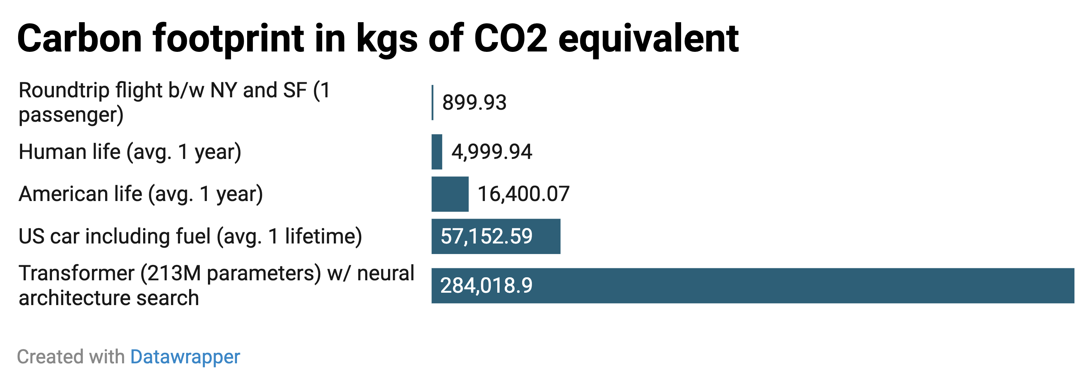

What’s the problem?
Computing requirements for artificial intelligence algorithms has grown
300 000x increase in computational requirements between 2012 and 2018
Source for data for graph: https://arxiv.org/abs/1906.02243
Image adapted from:
https://www.technologyreview.com/2019/06/06/239031/training-a-single-ai-model-can-emit-as-much-carbon-as-five-cars-in-their-lifetimes/
Notes:
OpenAI Blog looked at AI training runs for popular models over a 6 year period (2012 - 2018)
3.5 month-doubling time.

Slide 3
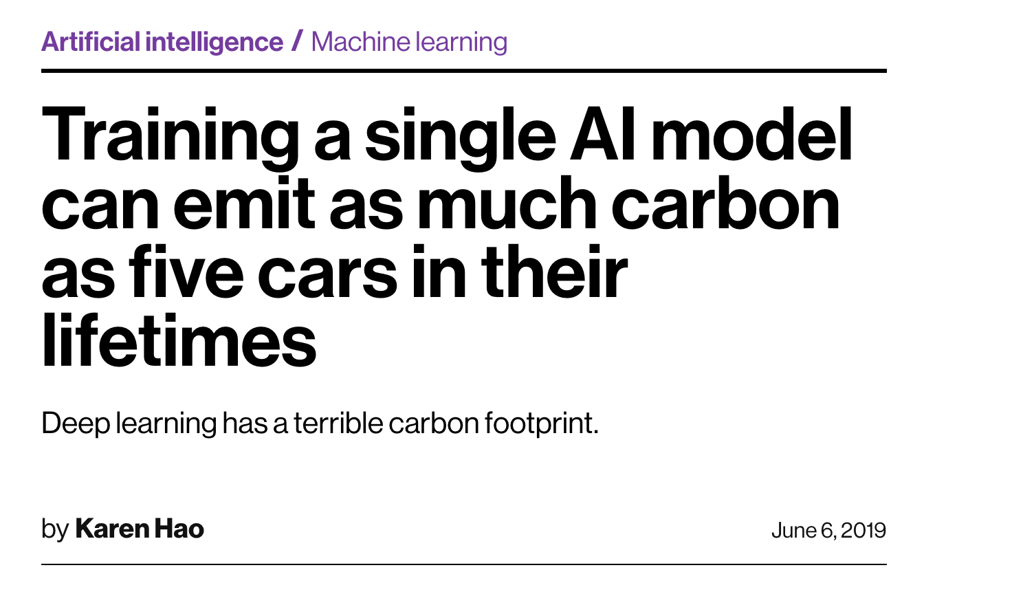
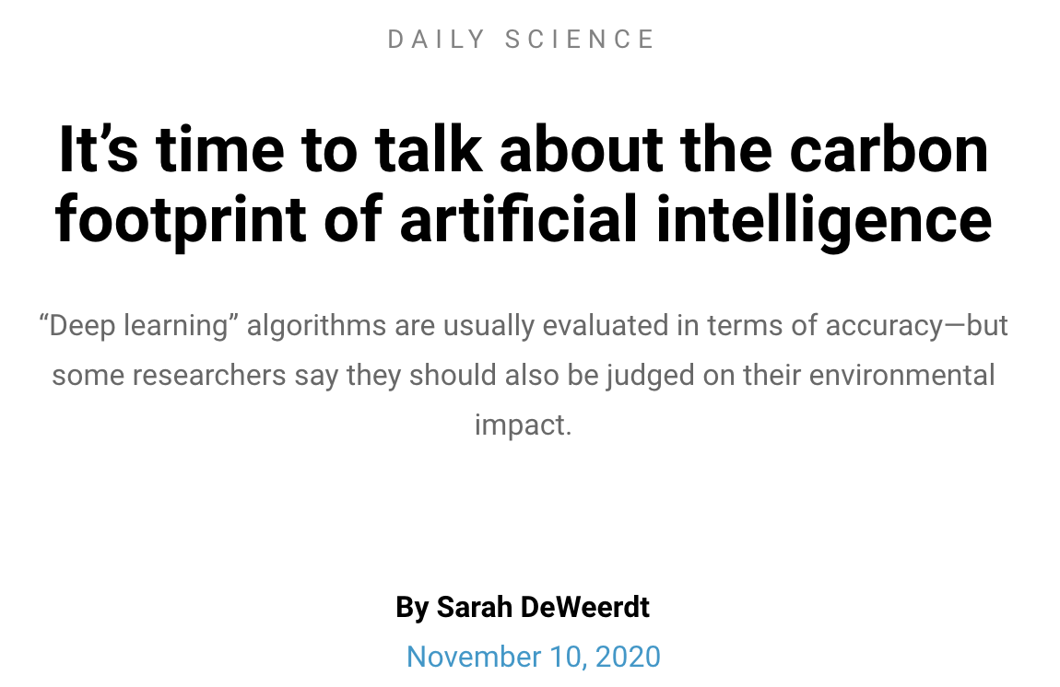
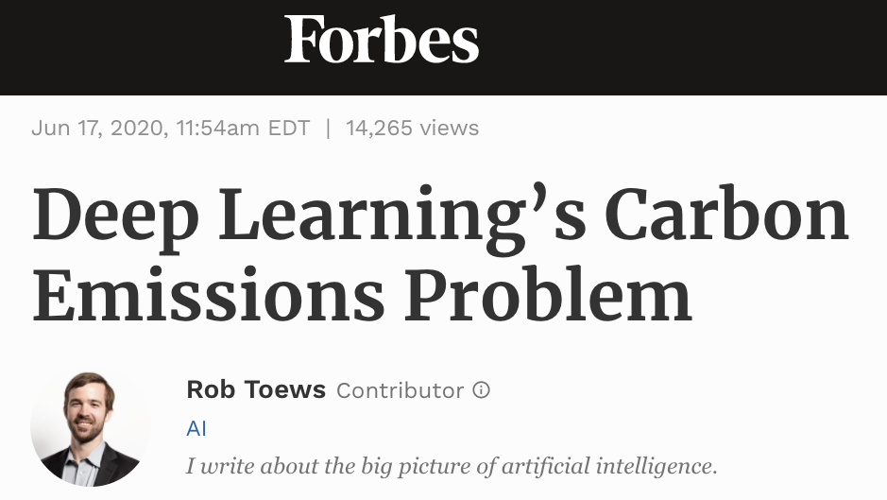
What’s the problem?
Not widely publicised, only gaining attention over the last two years

Slide 4
What’s the problem?
Not widely publicised, only gaining attention over the last year
The worry is that the carbon footprint of these algorithms are environmentally unsustainable

Slide 5
What’s the problem?
Not widely publicised, only gaining attention over the last year
The worry is that the carbon footprint of these algorithms are environmentally unsustainable
At the moment there is no requirement to disclose the energy expenditure of an AI project
Impossible to accurately report the carbon footprint for many algorithms

Slide 6
What’s the problem?
Not widely publicised, only gaining attention over the last year
The worry is that the carbon footprint of these algorithms are environmentally unsustainable
At the moment there is no requirement to disclose the energy expenditure of an AI project
Impossible to accurately report the carbon footprint for many algorithms
Many of the data ethics regulators do not list environmental impact in their considerations

Slide 7

What do I mean?
Example: GPT-3
Largest AI model in history
Language model created by OpenAI
Used 552 metric tons of CO2 during model training
Same as driving 120 cars for 1 year
ref_1

Slide 8
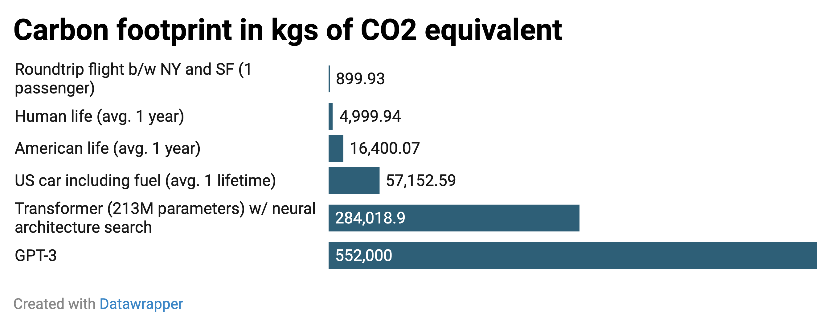
What do I mean?
Example: GPT-3
2019
2020
ref_1

Slide 9
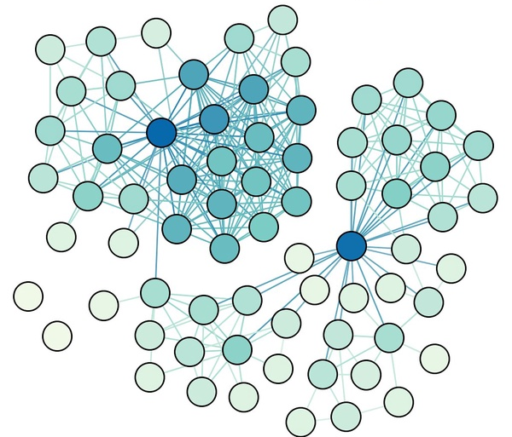

Solutions
The carbon footprint of AI training can be reduced by:
modifying the AI design
using ‘sparse’ neural networks
selecting better computer hardware
computer chips specifically designed for neural networks instead of graphics processing chips
ref_1
ref_2

Slide 10


Solutions
The carbon footprint of AI training can be reduced by:
modifying the AI design
using ‘sparse’ neural networks
selecting better computer hardware
computer chips specifically designed for neural networks instead of graphics processing chips
using renewable energy sources to generate the electricity required
using cloud computing
BUT this could result in a monopoly by the current ‘big players’
ref_1
ref_2

Slide 11

Conclusion
Need a standardised method for measuring energy consumption and carbon footprint for AI development
ref_1
ref_2

Slide 12

Conclusion
Need a standardised method for measuring energy consumption and carbon footprint for AI development
Need to include the environmental impact when considering ethics of large AI models
Many current data ethics committees do not list this
e.g. no mention in the Open Data Institute’s Data Ethics Canvas
ref_1
ref_2

